Slide 1
Kirton & Falkenham Village Meeting 24th August 2018

Slide 2
Agenda
Welcome & Introduction
K&F Housing proposal in draft Local Plan
Response to SCDC arising from 2017 Village Meeting
Comments & questions from the audience
Innocence Farm proposal in draft Local Plan
Response to SCDC arising from 2017 Village Meeting
Draft response from combined local Parish Councils
Comments & questions from the audience
Next steps
Close

Slide 3
Housing Proposal in“Draft Local Plan”

Slide 4
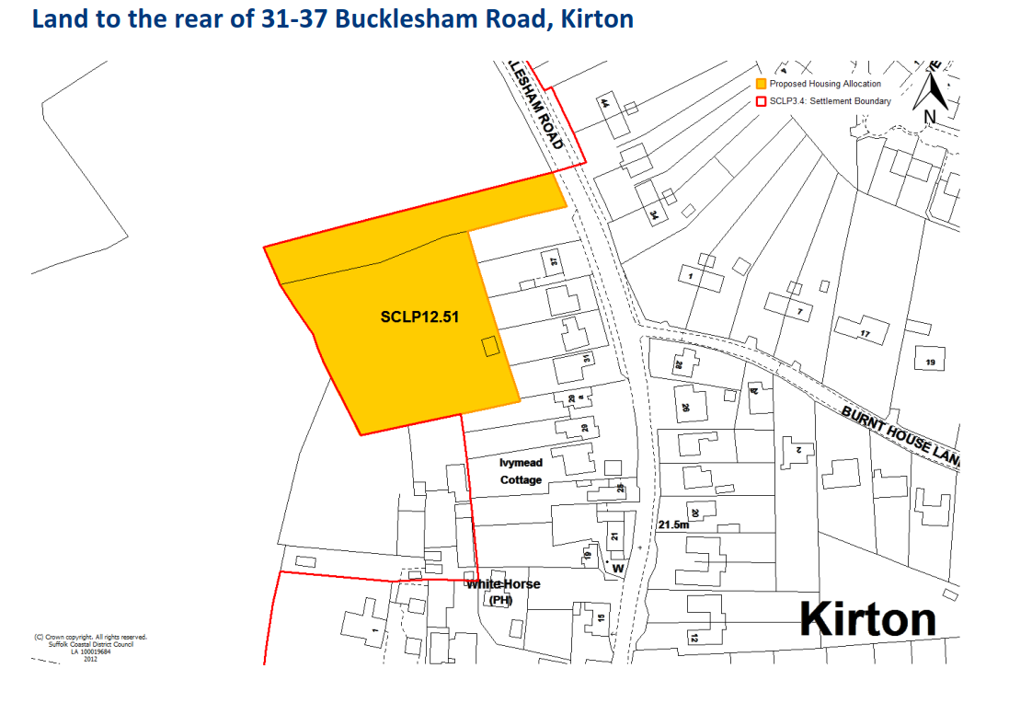
One site in Kirton & Falkenham proposed for housing during period to 2036
SCDC Policy team estimate 12 dwellings.
However the same team’s estimates proved to be a great understatement in the number of houses for Paddock Close.

Slide 5
Key Points from last years village meeting on the “Issues & Options” draft.
What facilities do you want? Post Office and/or a shop.
Many raised the point that if you live in a village you do not expect a wide range of facilities.
Many felt that the surrounding countryside was important and of high value
Planners must include affordable homes and they must be insisted upon.
Developers rarely include bungalows and they must be included.
Fewer people were in individual households (older people/ single households) and therefore smaller houses were needed not 5 bedroom homes
There are currently not enough places at Trimley St Martin School

Slide 6
Comments & questions from the audience

Slide 7
Backup Slides

Slide 8
Current Local Plan (approved by Government 2017)

Slide 9
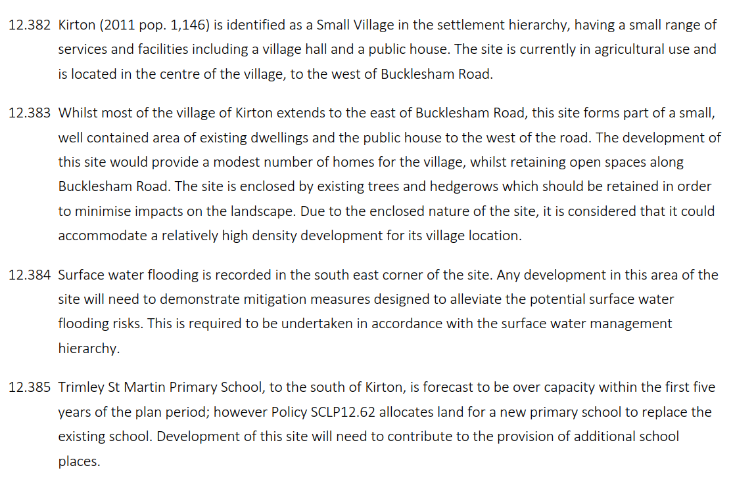
Draft Local Plan

Slide 10
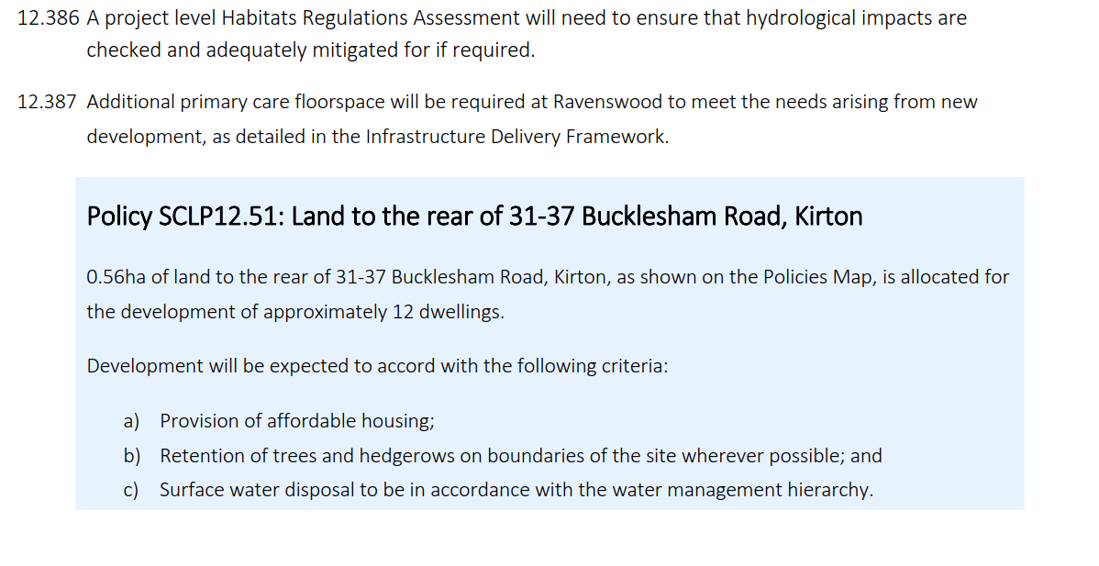
Draft Local Plan

Slide 11
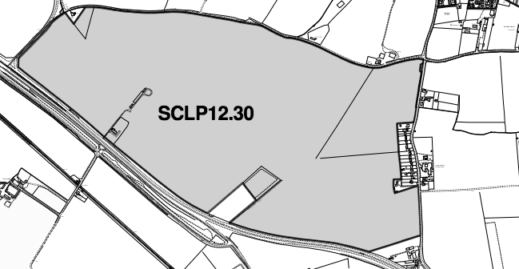
Innocence Farm in Draft Local Plan
“Large scale employment land allocation at Innocence Farm to support the continued viability of the Port of Felixstowe and other related businesses including HGV parking and small scale complementary uses which serve the ancillary needs of the businesses operating at this site”

Slide 12
Innocence Farm 2017 response objections
Pollution (fumes, light, noise)
Brownfield sites remain unused
Greenfield sites with planning permission have not been developed
Land banking
Government stats show low level of historic growth (freight & land)
No traffic impact assessment completed (3,200 HGVs per day)

Slide 13
Innocence Farm 2018 ‘Joint PC’ objections
Three main issues:
Is there a need for a site of this size for port related use?
If there is a need, is Innocence Farm the right location?
What reassurance is offered to local people that the environmental impacts going to be properly addressed and their interests protected?

Slide 14
Need for a site for port related use?
No evidence for a site of 116 Hectares (ha)
Lichfield study forecasts for off-port land:
26.3 ha (low case)
103.8 ha (high case)
66.9 ha (central case)
67 ha existing pipeline supply of suitable employment land in close proximity to the Port of Felixstowe
Case for land east of Orwell is suspect
Existing permissions of 166 ha between Bury St. Edmunds & Port of Felixstowe
60% greater than demanded by high case
No interworking between District Councils to ensure best outcome

Slide 15
Is Innocence Farm the right location?
Lichfield evaluation of 10 sites is illogical & unscientific:
Only six criteria are used, and each have equal weighting
No consideration to strategic siting eg east or west of A14, proximity to railway etc
Infrastructure development costs (eg road access) not sufficiently addressed
Markings against each criteria are perverse eg a mark of 5 if land owner is deemed to have put forward land for port related use
Traffic study does not reflect the proposed site use
No suggestion that new road access is required
No assessment of increased HGVs with or without new road access

Slide 16
Mitigation of environmental impact
Residential property backs onto the land
Primary school only a short distance away
24 hour working with the resultant air pollution, light pollution and noise would be unconscionable in this rural environment
Proposed use is left open in the interests of ‘flexibility’
Provision of landscaping & buffers is not described in any detail
Leaving so much open is unacceptable for those living nearby who may face the possibility of 20 years of blight ahead
Residents need to have some certainty about the protection which will be provided for them

Slide 17
Comments & questions from the audience

Slide 18
Next steps
All responses to the draft Local Plan by 14th September
Organise a petition? Across all local Parishes??
Anything else?
~~~~~~~~~~~~~~~~~~~~
Find out about the proposals and keep up to date with what we’re doing about them on the PC website
Register for email updates on the PC website
www.kirtonandfalkenham.suffolk.cloud

Slide 19
Close

